Slide 1

Smart Buildings 5.0 (DRAMA) Name: Yonicel Leyva
Team Member(s): Roberto Murillo Product Owner(s): Ali Mostafavi
Instructor: Masoud Sadjadi School of Computing and Information Sciences Florida International University
Senior Project Final Presentation
Summer 2016
8/5/2016
Notes:
7 seconds.
Greet your audience, thank them for attending your presentation, introduce yourself, introduce your project, introduce your team members, and quickly indicate what each of you did in a high-level manner, and put more emphasis on your part/contribution.

Slide 2
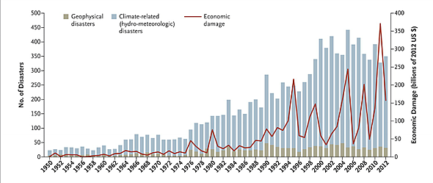
Project definition
The frequency of natural disaster has increased in the last 50 years. In the aftermath, disaster agencies have to evaluate the damages and needs of the area, so they can distribute resources appropriately. The problem is that there is huge gap between the occurrence of the disaster and the completion of the assessment.
Notes:
10 seconds.
Introduce the problem that the whole project (in all versions) tackles with GIF or screenshot.

Slide 3
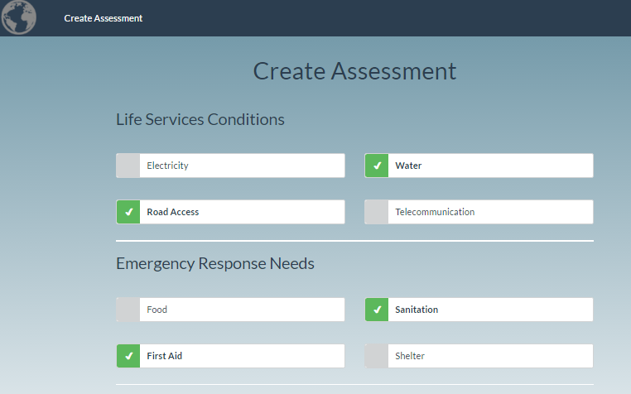
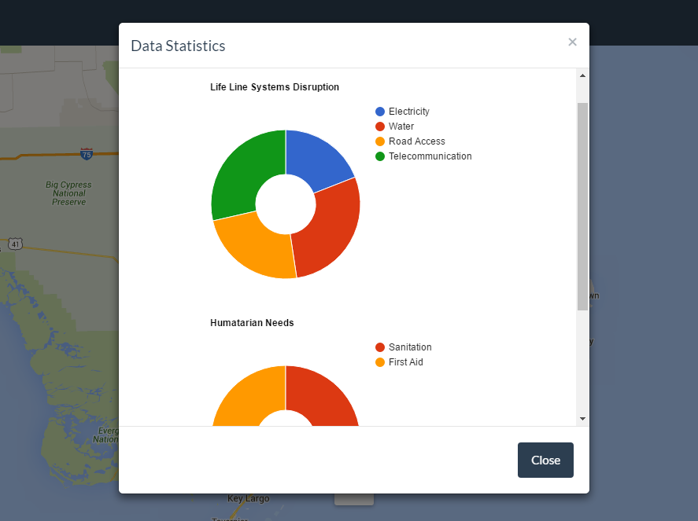
Project definition
We aim to solve the problem of need and damage assessment in the aftermath of the disasters. The web application creates a platform for crowdsourced information collection regarding needs and building conditions and a crowdsourced platform for evaluation of damages by people who have expertise.
Notes:
20 seconds.
Introduce the problem that the your project (in new version) tackles with GIF or screenshot.

Slide 4
Requirements: Use Cases
Notes:
5 seconds
Show the Use Case Diagram for the whole project. Highlight your use cases.

Slide 5
System Design: Architecture
Notes:
20 seconds
System design: Highlight the parts that you contributed to them.
1. System decomposition; identify the architecture patterns used
2. System deployment – h/w and s/w requirements

Slide 6
Minimal Class Diagram
Notes:
10 seconds.
Minimal class diagram. Highlight the classes that you created/modified
Identify the design patterns used (one or more slides).

Slide 7
User Stories
1. Create Mapping Report
2. View Report Marker
3. Select Report Markers
4. Filter Report Markers
5. Review Evaluator
Notes:
5 seconds.
List the user stories that you worked on them.(put in order of importance). Stay focused on the parts that you have been working.

Slide 8
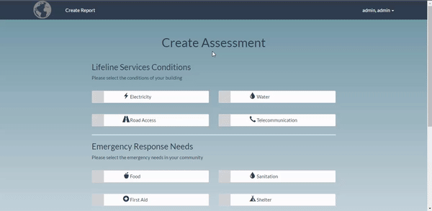
User Story #1: Create Mapping Report
Created form for users to provide information about needs and the state of the area where they live.
The second section of the report allows the user to upload photos with gps location of the affected area.
Shows a gallery of the photos the users are uploading.
Notes:
60 seconds
The tile of user story
The most important user story you worked on it. You have to describe this one very well and be proud of that.
Please present and show the complexity of your work, code, algorithms, and technical challenges and technologies you have used. (you could use screenshot if you want. Visual presentations are better than text presentation)
Go into the details of the most important/significant tasks using bullet lists or visual graphs or state chart diagram
Sequence Diagram for this user story is mandatory (in another separate page if required)
Demo using screenshots or GIF (in another separate page if required)

Slide 9
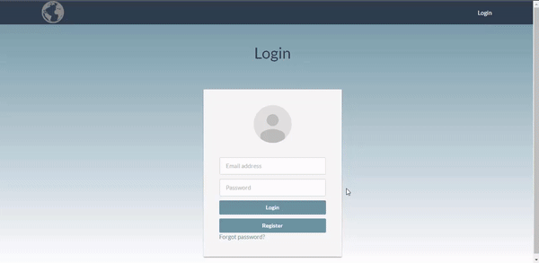
User Story #2: View Report Markers
Created functionality that creates location markers on a map
All mapping reports that are created by user are represented as markers on a map.
The reports are accessible by clicking on the markers and then clicking on the “View Report” link.
Notes:
20 seconds
The tile of user story
Please present and show the complexity of your work, code, algorithms, and technical challenges and technologies you have used. (you could use screenshot if you want. Visual presentations are better than text presentation) - Go into the details of the most important/significant tasks using bullet lists or visual graphs or state chart diagram - Demo using screenshots or GIF (in another separate page if required)
Sequence Diagram for this user story is optional

Slide 10
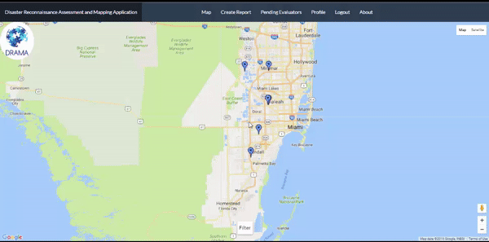
User Story #3: Select Report Markers
Created functionality to select report markers on the map and show statistics related to those reports.
The user creates a circle shape on the map and any markers within the radius will be selected
When the selection is applied the app will show grouped information.
Notes:
20 seconds
The tile of user story
Please present and show the complexity of your work, code, algorithms, and technical challenges and technologies you have used. (you could use screenshot if you want. Visual presentations are better than text presentation) - Go into the details of the most important/significant tasks using bullet lists or visual graphs or state chart diagram - Demo using screenshots or GIF (in another separate page if required)
Sequence Diagram for this user story is optional

Slide 11
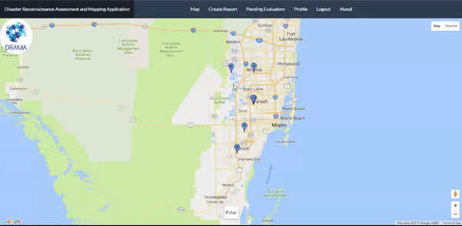
User Story #4: Filter Report Markers
Created a form for users to filter report markers on the map.
Users can choose between various options to filter markers that are of interest.
When the filter is applied only markers related to the filters will show on the map.
Notes:
20 seconds
The tile of user story
Please present and show the complexity of your work, code, algorithms, and technical challenges and technologies you have used. (you could use screenshot if you want. Visual presentations are better than text presentation) - Go into the details of the most important/significant tasks using bullet lists or visual graphs or state chart diagram - Demo using screenshots or GIF (in another separate page if required)
Sequence Diagram for this user story is optional

Slide 12
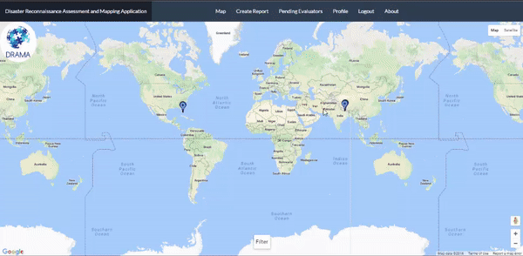
User Story #5: Review Evaluators
Newly Evaluator accounts need to be approved by admin user
Created form that allows admin user to review evaluators pending for approval.
Approved evaluator users will receive a notification email and immediate access to the application
Notes:
20 seconds
The tile of user story
Please present and show the complexity of your work, code, algorithms, and technical challenges and technologies you have used. (you could use screenshot if you want. Visual presentations are better than text presentation) - Go into the details of the most important/significant tasks using bullet lists or visual graphs or state chart diagram - Demo using screenshots or GIF (in another separate page if required)
Sequence Diagram for this user story is optional

Slide 13
Test Case
Test Case ID | SB_CreateAssessment_01 (Sunny Day)
Purpose | Verify that the upload picture functionality works
Preconditions | The server and application are up and running User is logged into the system Assessment form is currently displayed
Input | User fills the form with the data below Choose File: C:\...\picture.jpg
Expected Output | Immediately upon selecting the image, the user is able to see a thumbnail of the picture
Notes:
10 seconds
A description of verification process and Test Suites and Test Cases for one of the use cases.
1 One sunny day and one rainy day for the implemented use cases (one or more slides).
2 Automated test scripts for the implemented use cases (if any) (one or more slides).

Slide 14
Test Case
Test Case ID | SB_CreateAssessment_02 (Rainy Day)
Purpose | Verify that user cannot upload more than the total size limit
Preconditions | The server and application are up and running User is logged into the system Assessment form is currently displayed
Input | User fills the Assessment form with the data below Choose Files: 10 files
Expected Output | Immediately upon selecting the images, the user receives a message that total number images to upload has exceeded the limit.
Notes:
10 seconds
A description of verification process and Test Suites and Test Cases for one of the use cases.
1 One sunny day and one rainy day for the implemented use cases (one or more slides).
2 Automated test scripts for the implemented use cases (if any) (one or more slides).

Slide 15






Summary
yleyv007@fiu.edu
Questions?
Thank You!
Notes:
10 seconds
Summarize your contribution, mention your effort for Scrum, Mingle, Github, Google Drive Documentation and minutes
Include your contact information
Ask if anyone has any questions for you.
Thank your audience

